Slide 1
Neural Object Detection
Ilya Zakharkin | Deep Learning School

Slide 2




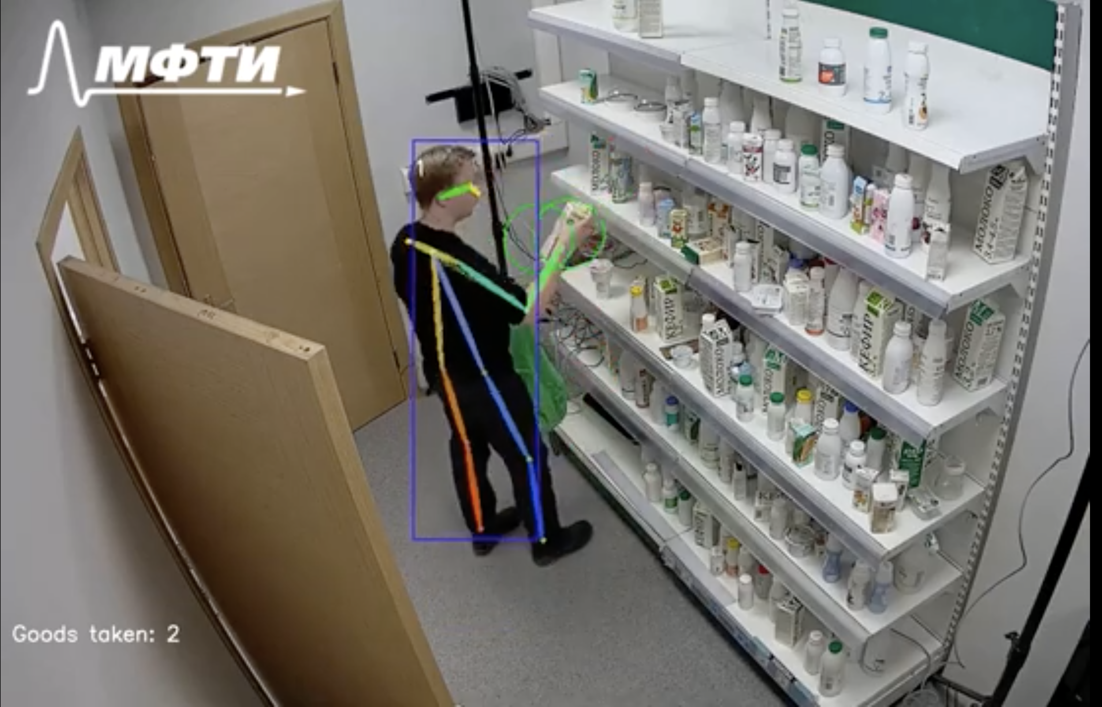

About

Slide 3


About
https://www.jesture.ai/

Slide 4
Lecture plan
Classification recap
Object Detection basics
Two-stage (proposal-based) methods
One-stage (single-shot) methods
Modern approaches & tasks

Slide 5
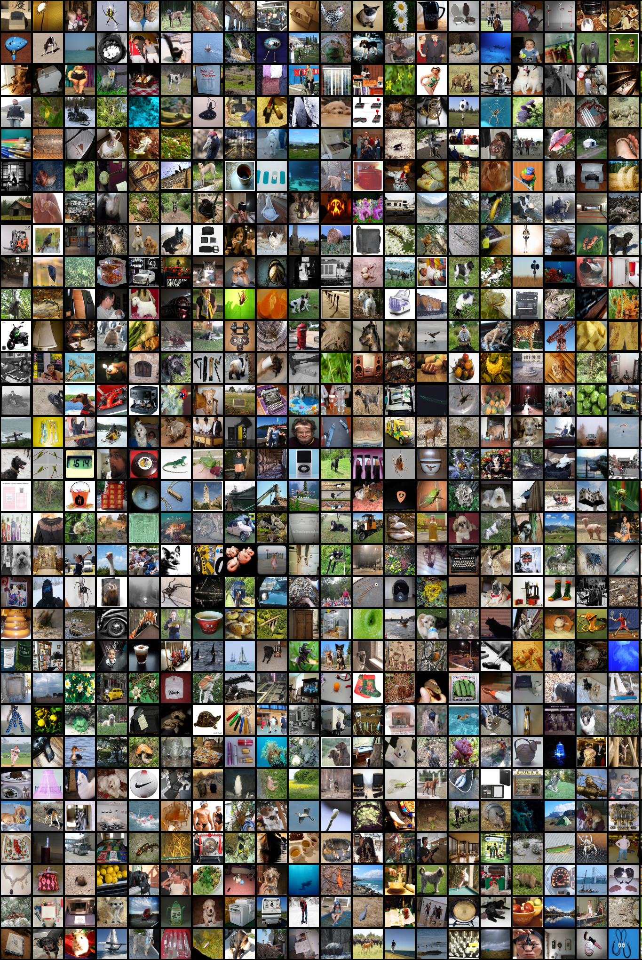
Image
Classification
Recap

Slide 6
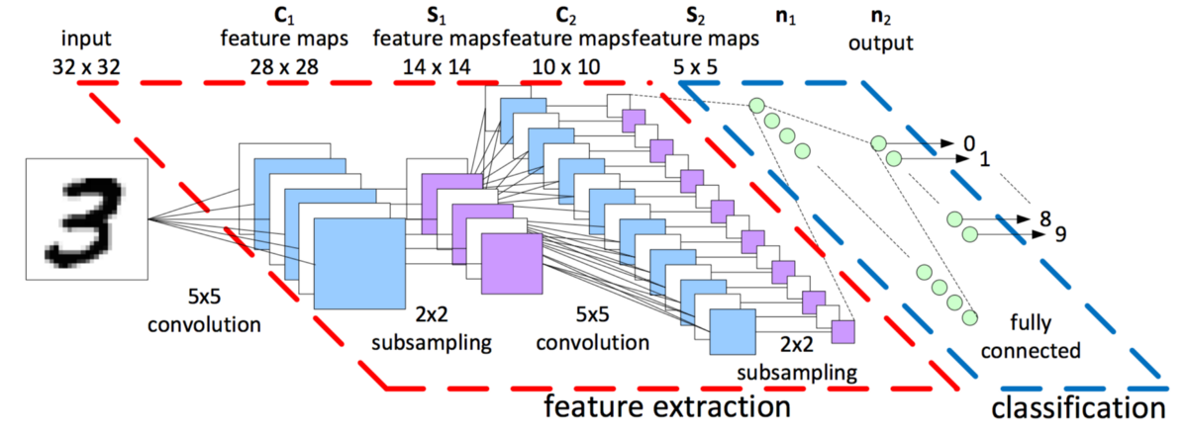

Slide 7
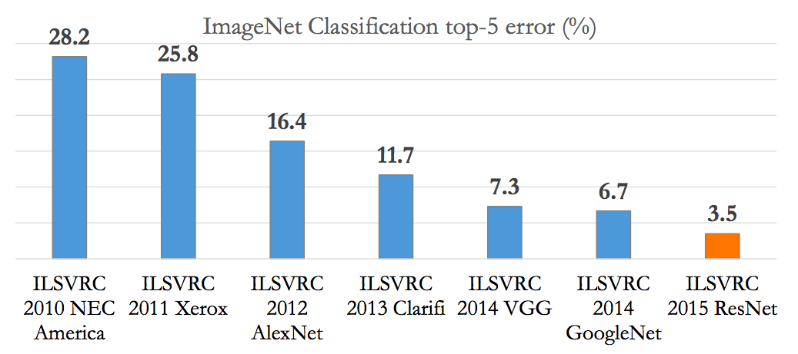
Classification: ILSVRC

Slide 8
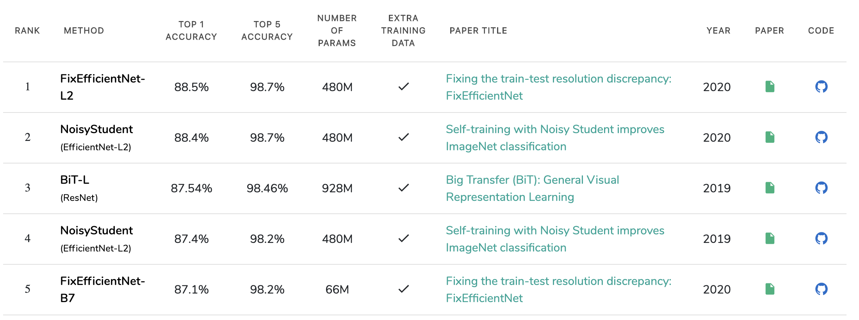
Classification: ILSVRC
https://paperswithcode.com/sota/image-classification-on-imagenet

Slide 9
Classification: ILSVRC
96.5%

Slide 10
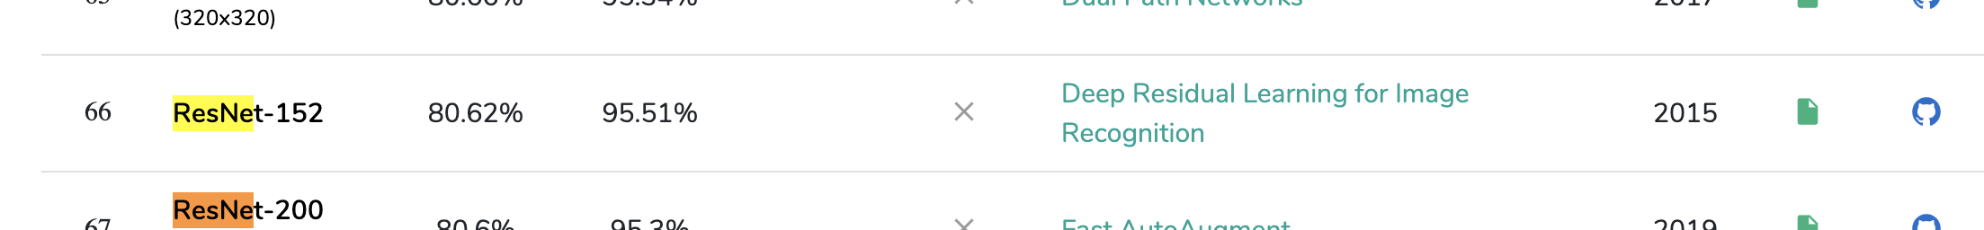

Classification: ILSVRC
96.5%

Slide 11
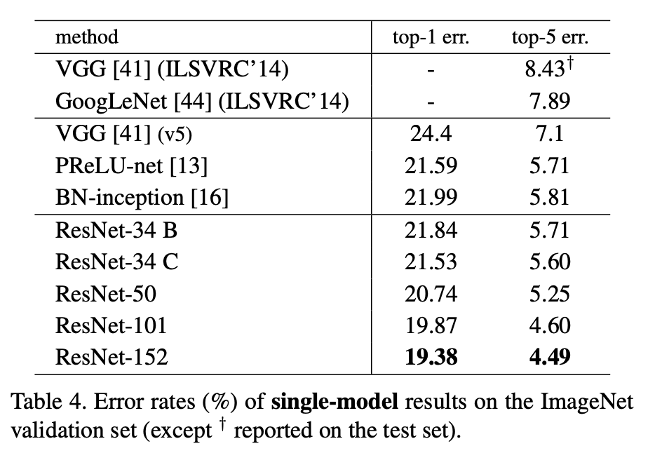
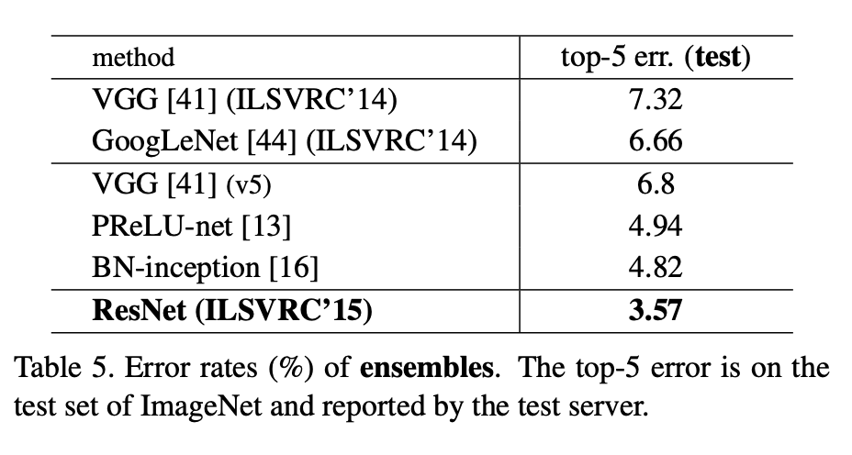
Classification: ILSVRC
https://arxiv.org/pdf/1512.03385.pdf

Slide 12
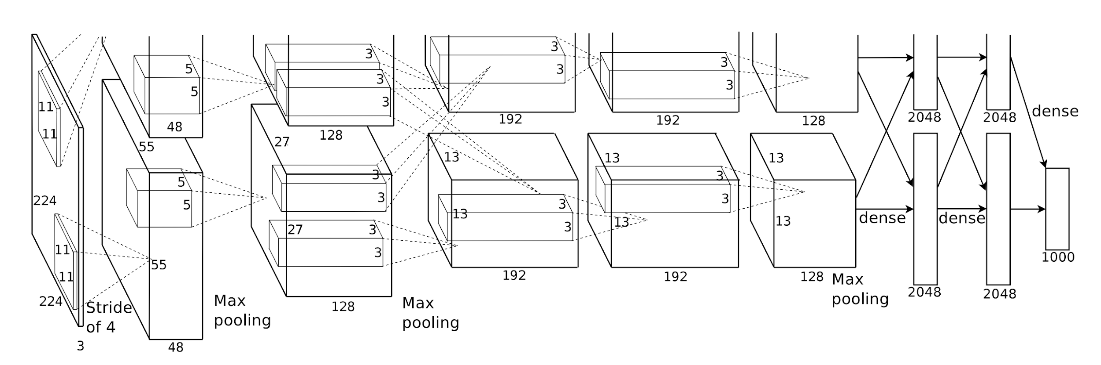
Classification: AlexNet
Idea: Conv -> Conv (= ConvBlock) + Deeper + GPU
Paper
Code: available in every framework

Slide 13
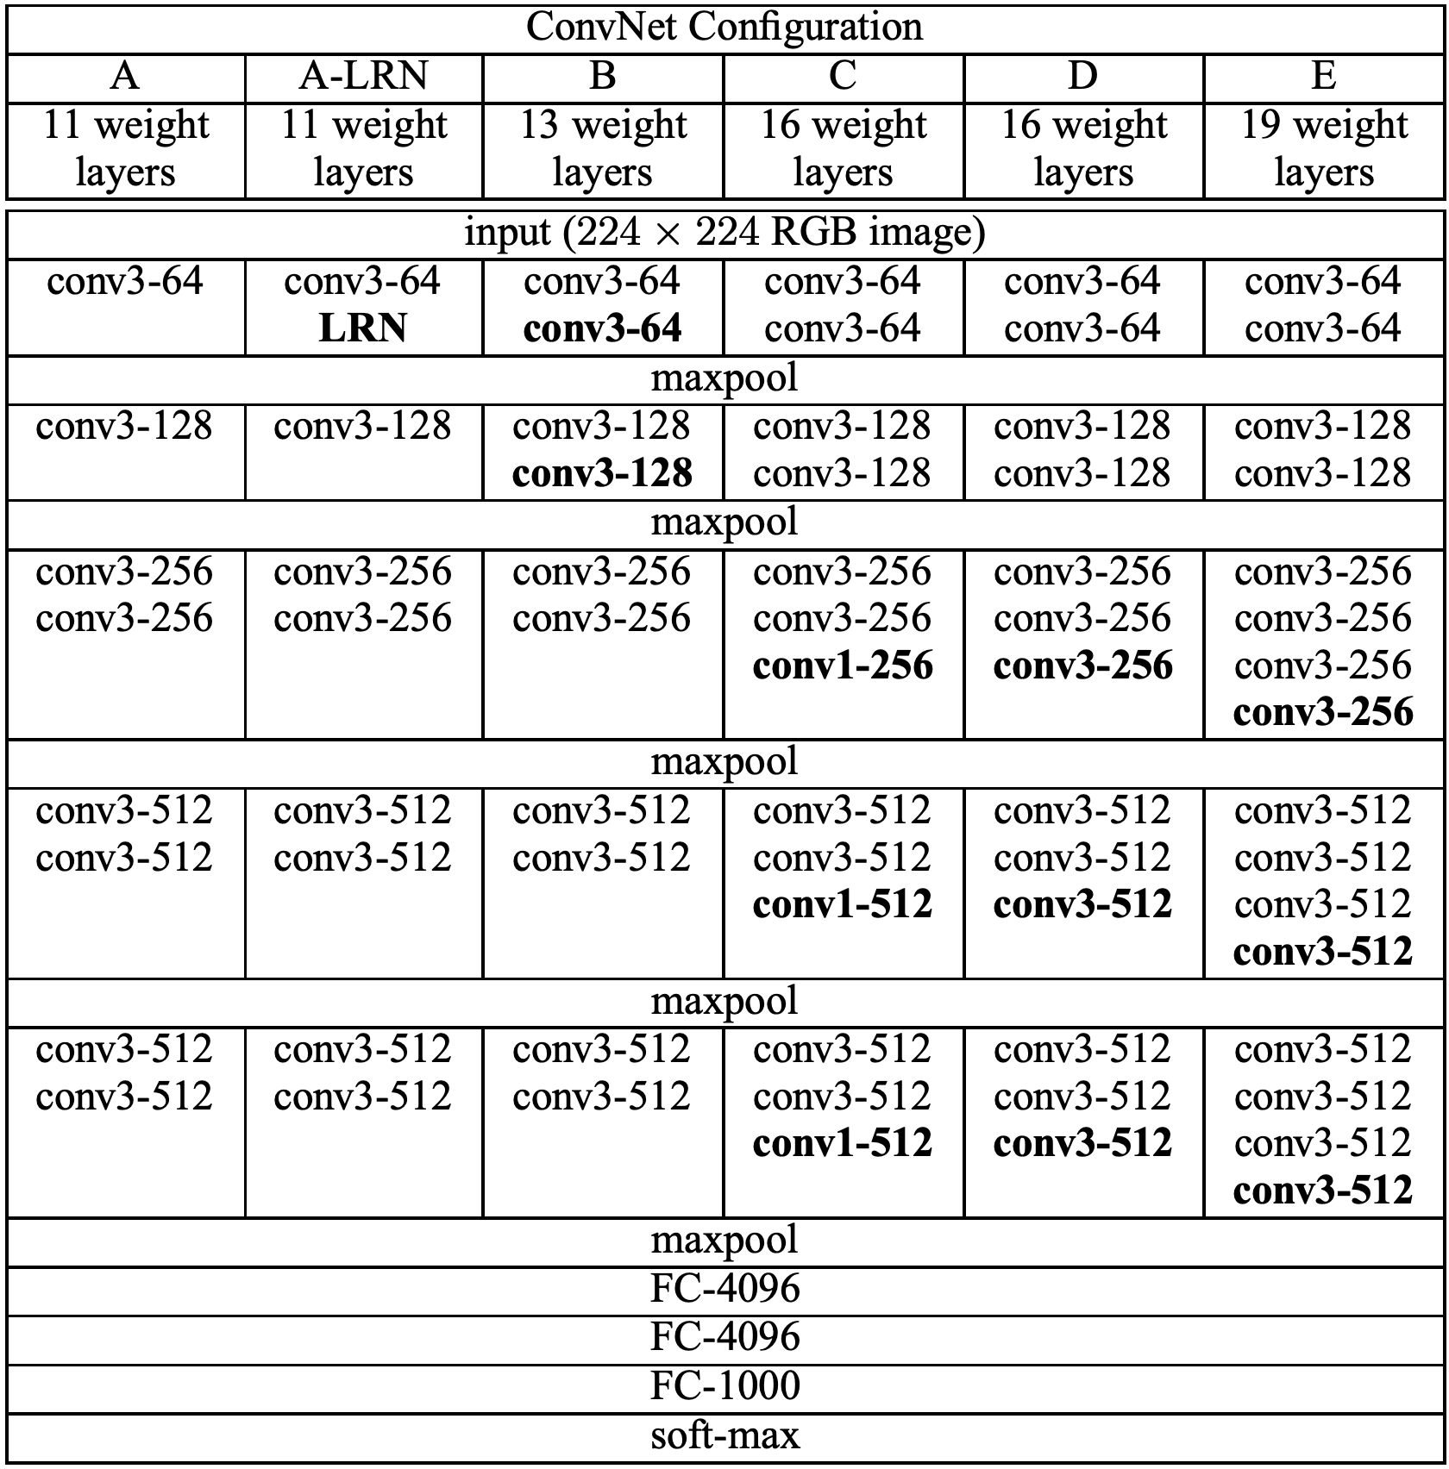
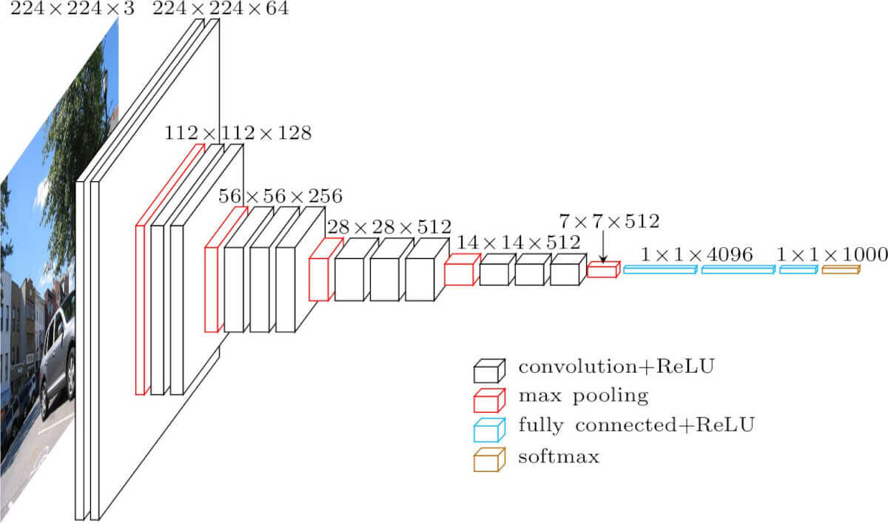
Classification: VGG
Idea: Several conv blocks (deeper net)
Paper
Code: available in every framework

Slide 14
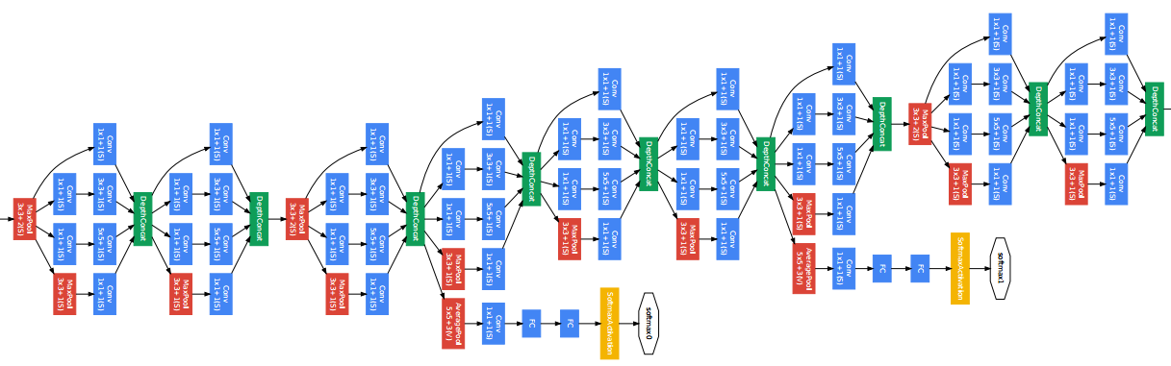
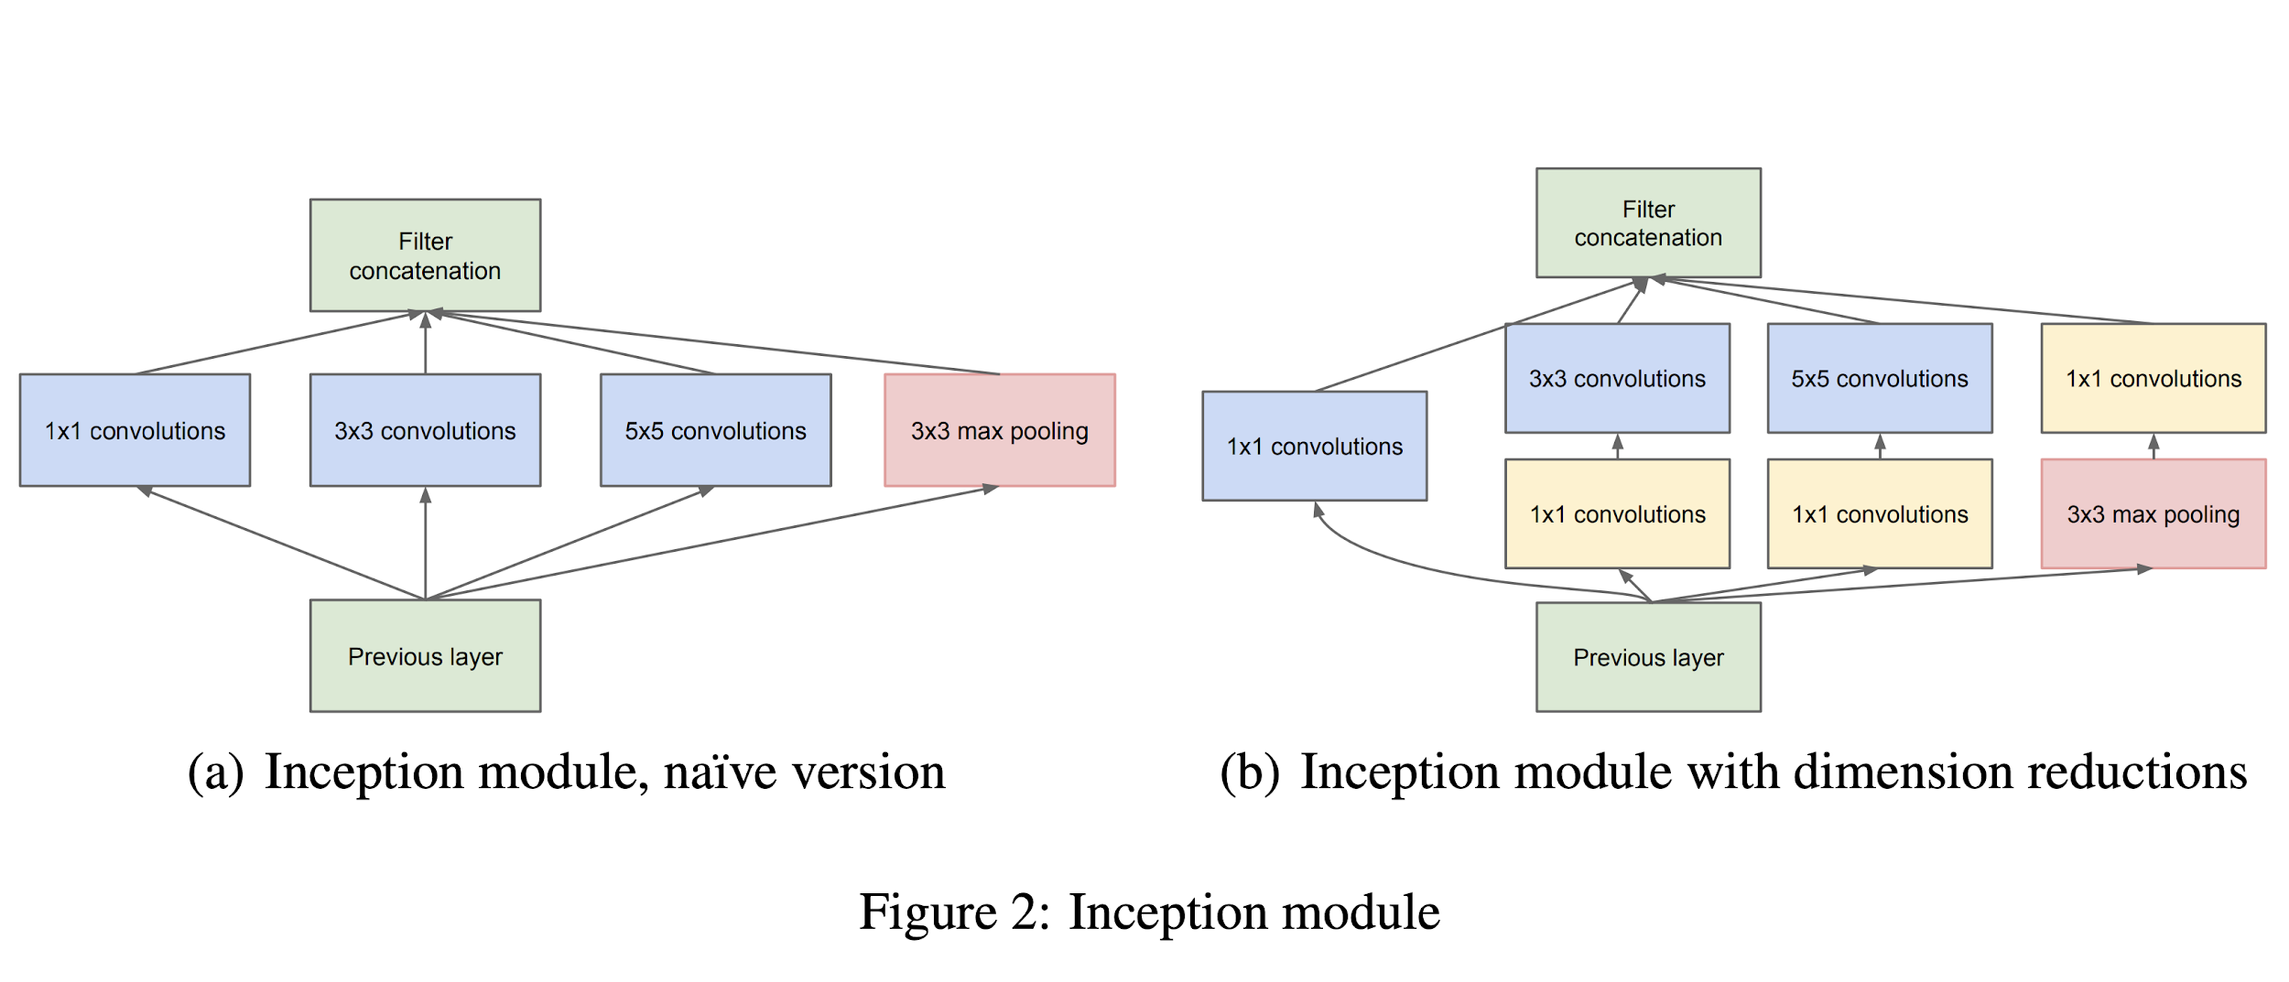
Classification: Inception (v1)
Idea: Inception-block + 1x1 conv + deep supervision
Paper
Code: available in every framework

Slide 15
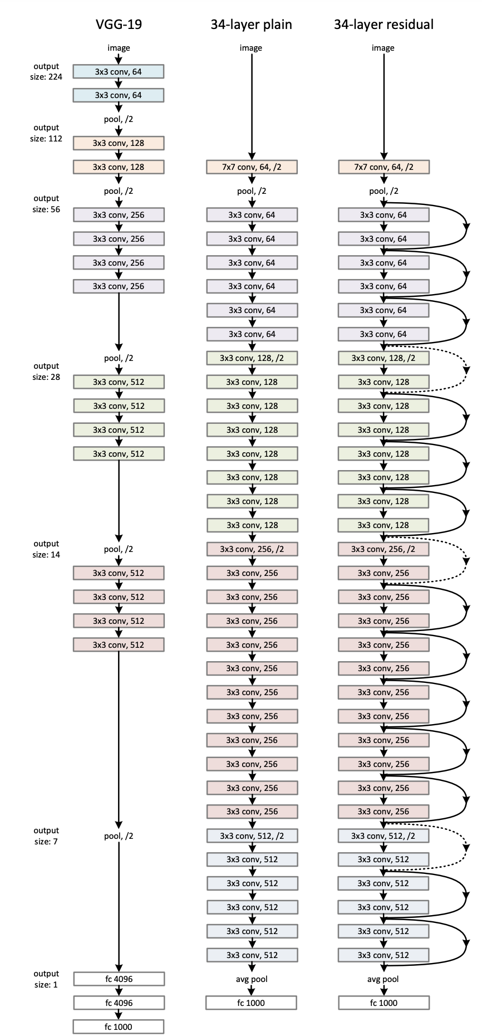
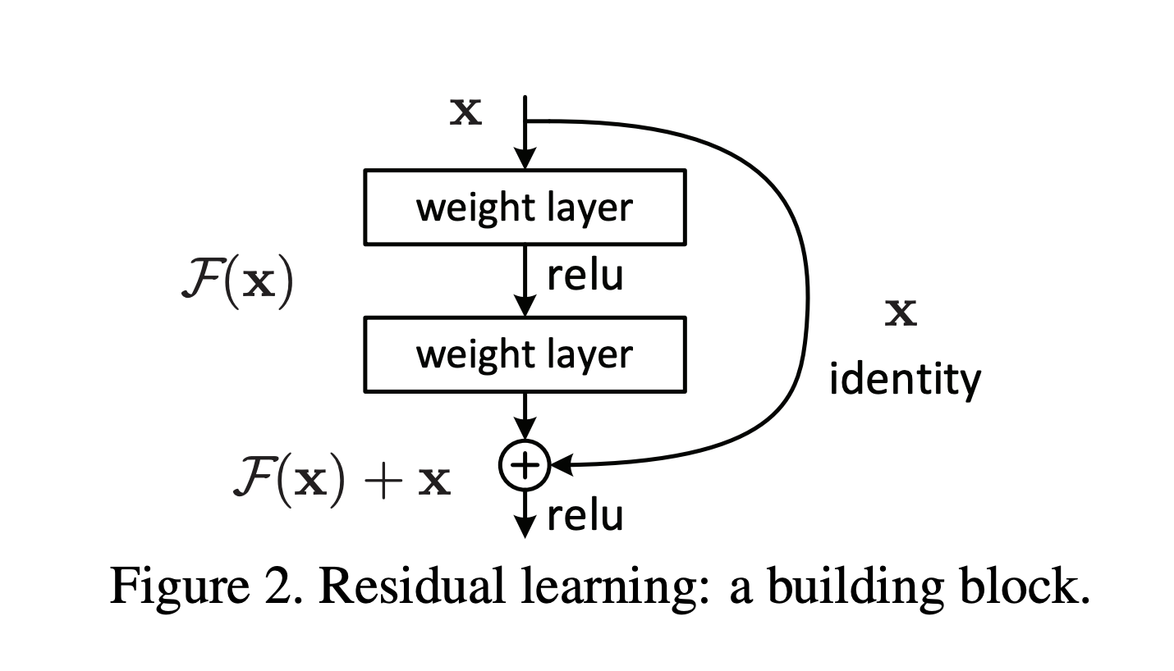
Classification: ResNet
Idea: Residual connections (Shortcuts)
Paper
Code: available in every framework

Slide 16
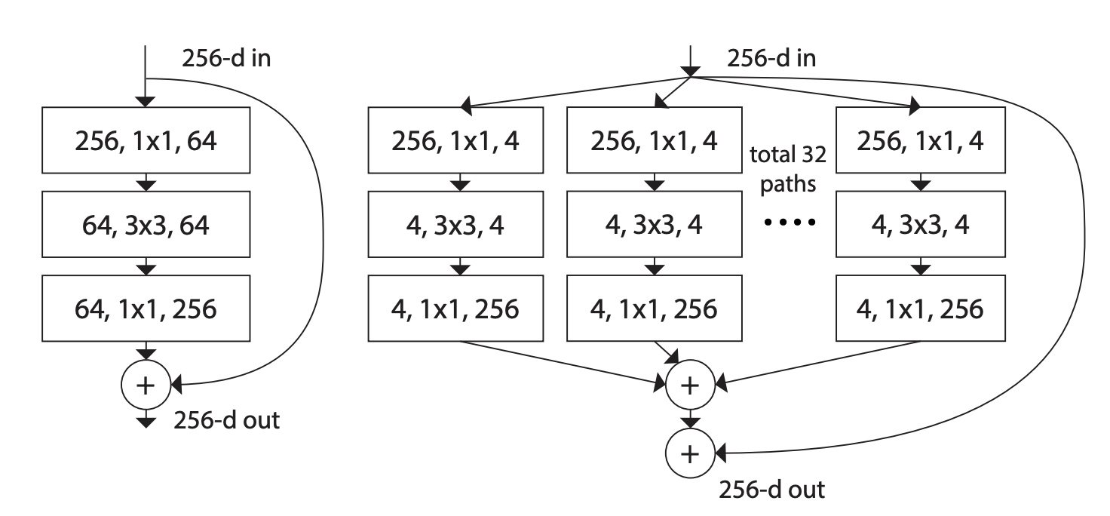
Classification: ResNeXt
Idea: Aggregated residual blocks
Paper
Code
Bottom: Cardinality (C) = 32, d = 4

Slide 17
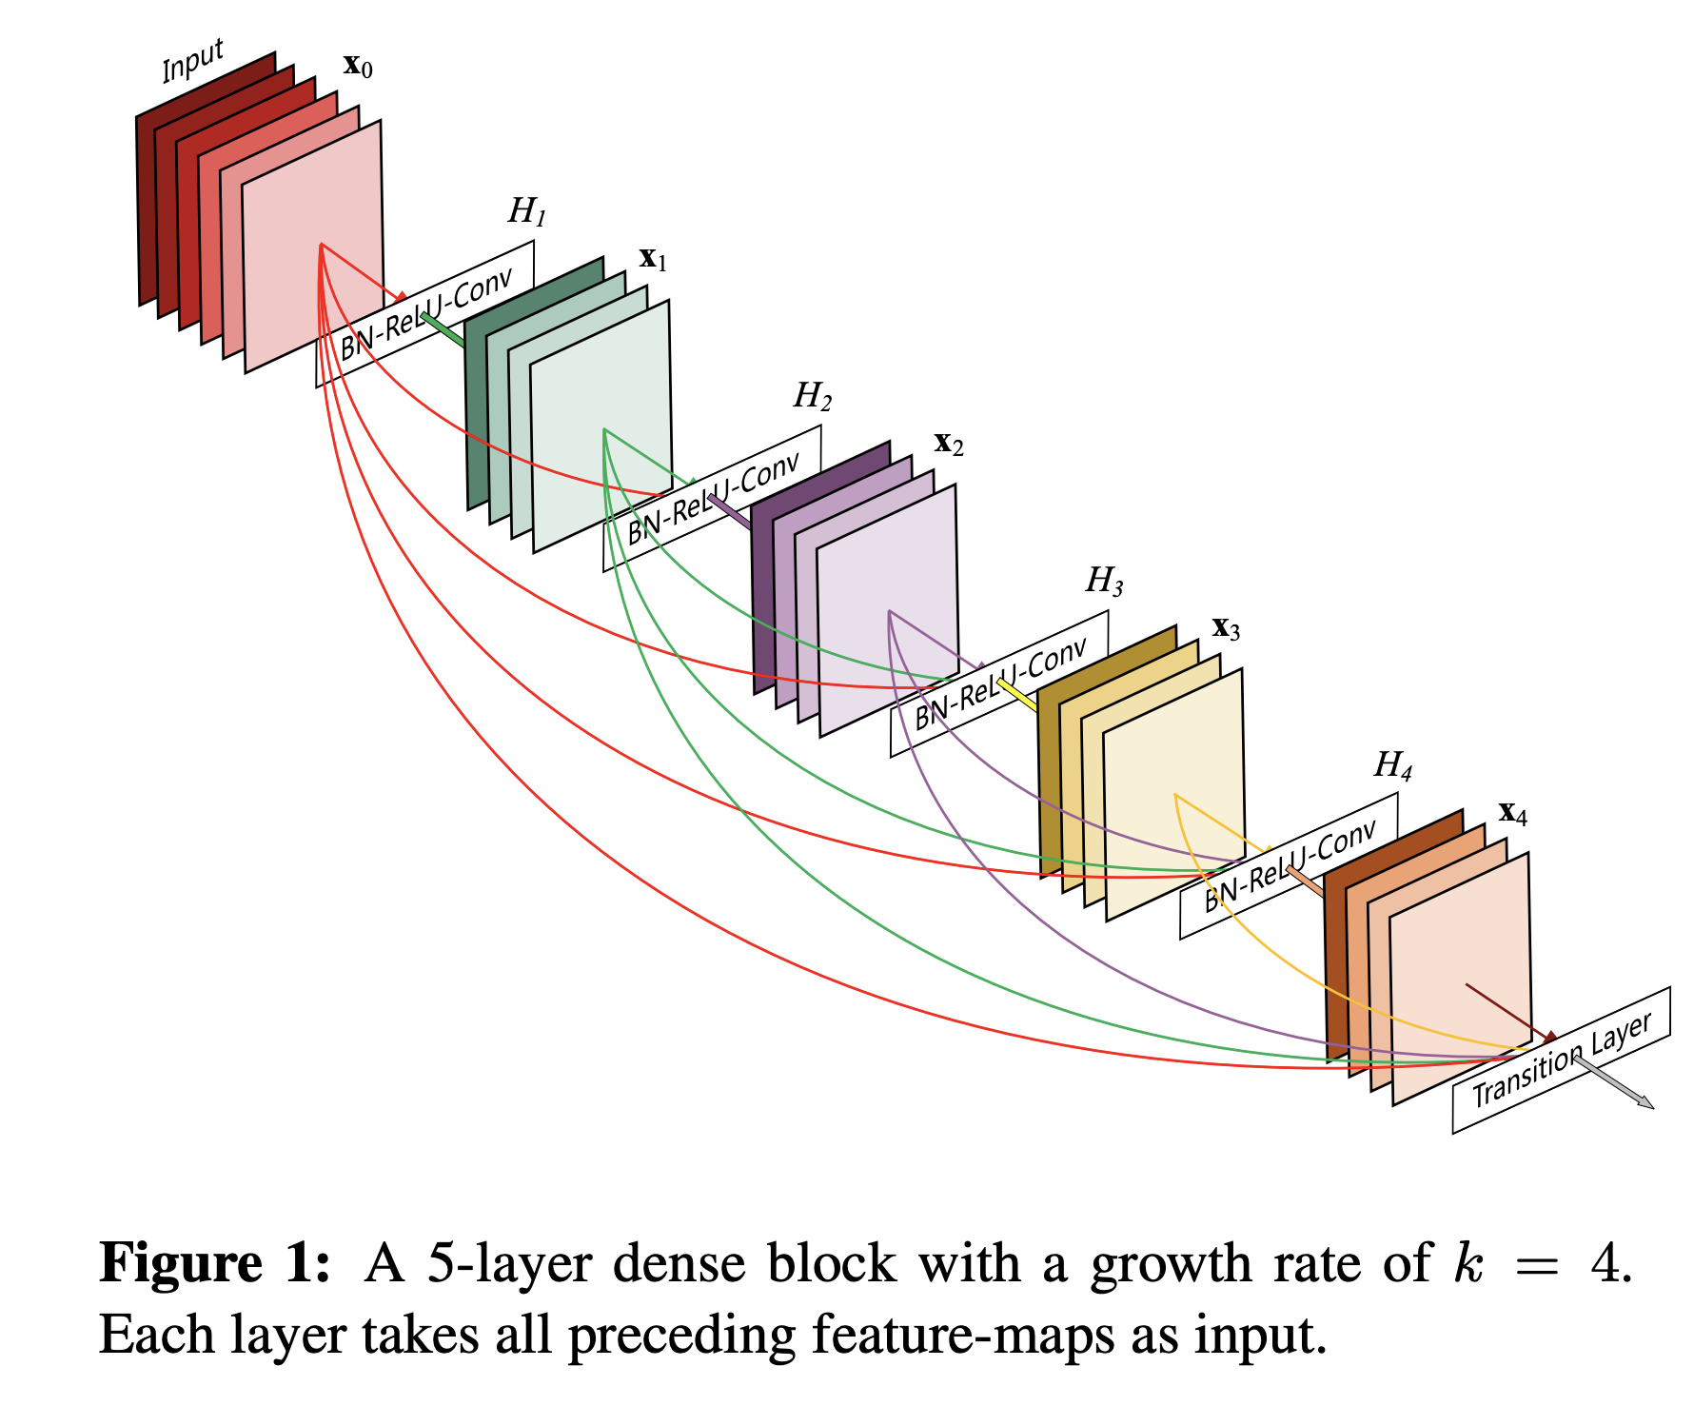
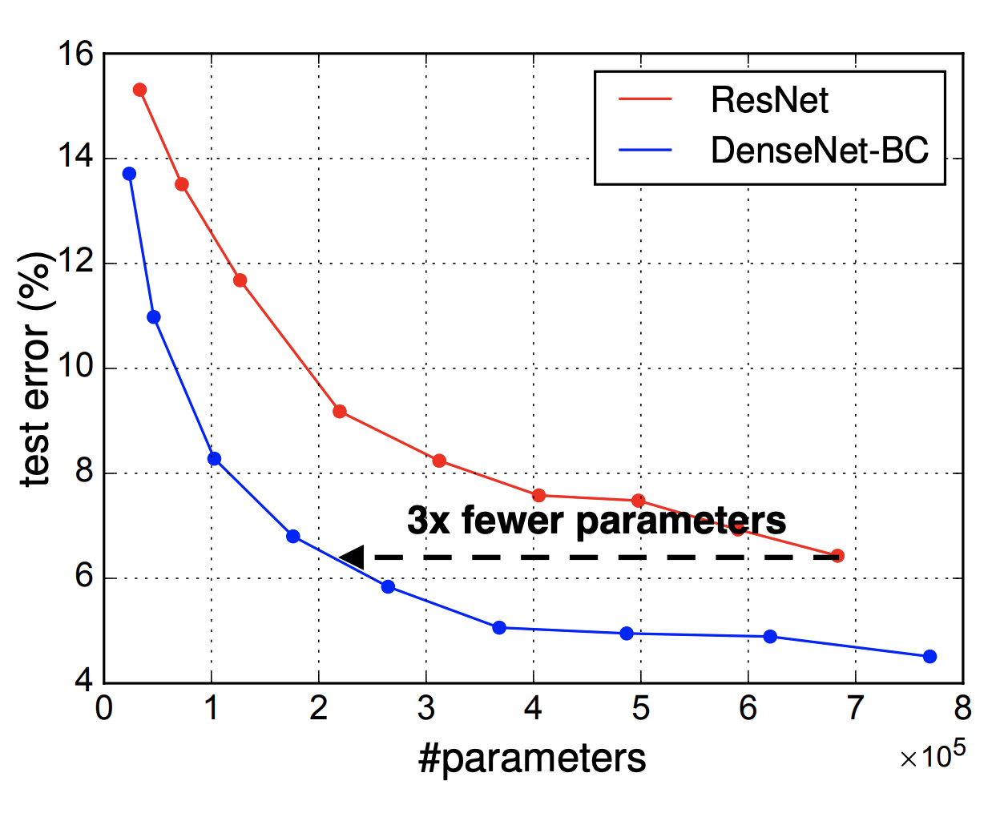
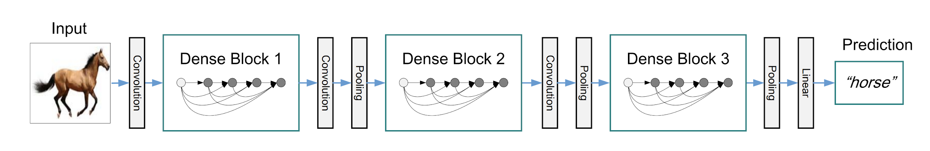
Classification: DenseNet
Idea: Dense block
Paper
Code: torchvision / tf.models

Slide 18
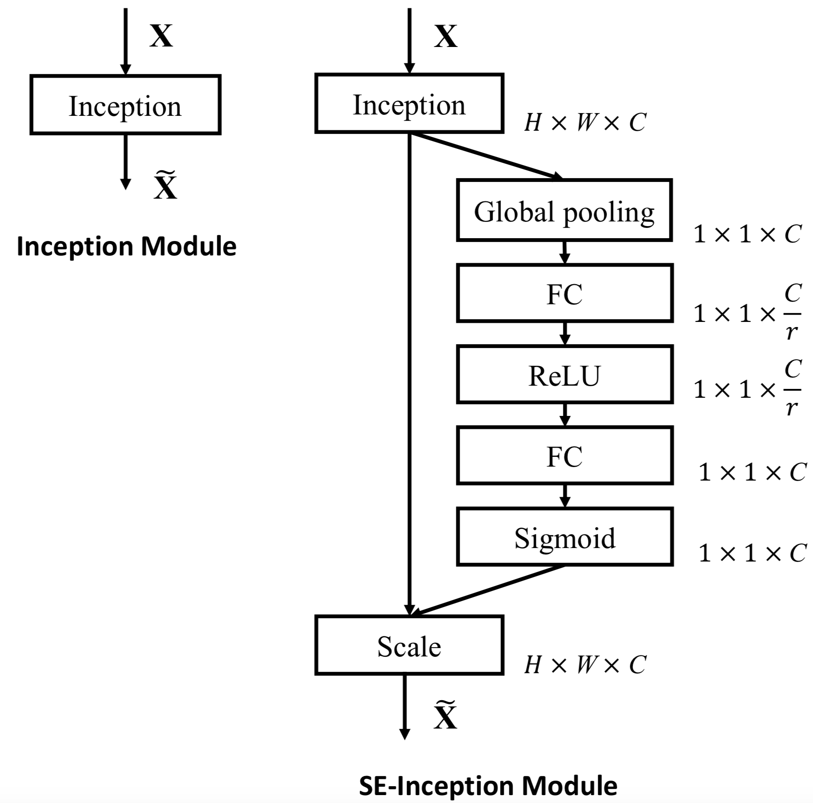
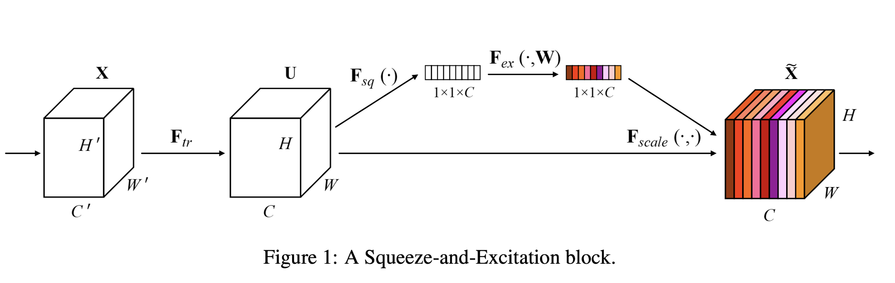
Classification: Squeeze-and-Excitation Net (SENet)
Idea: SE-block
Paper
Code

Slide 19
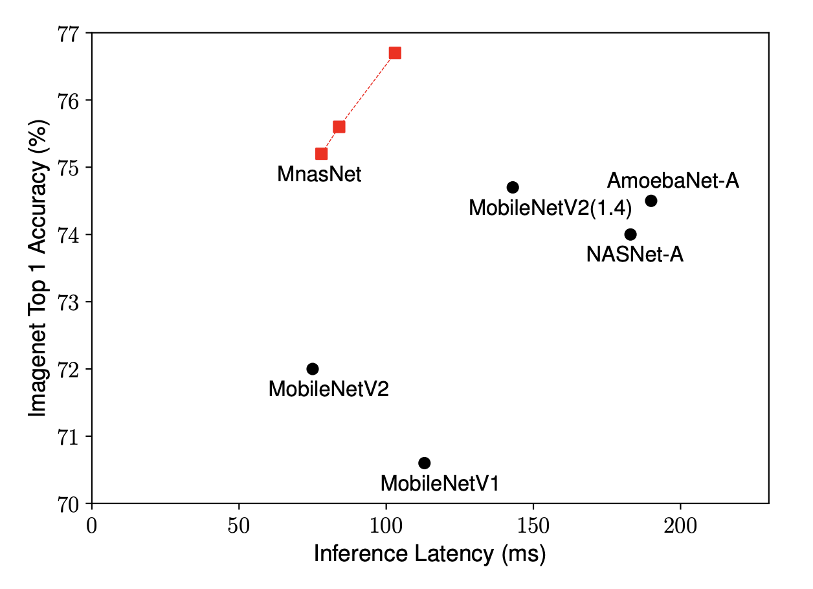
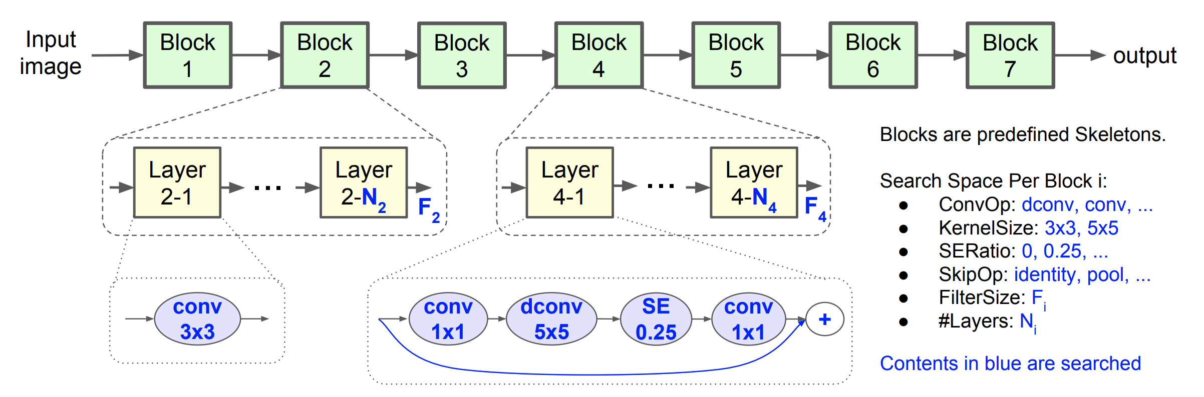
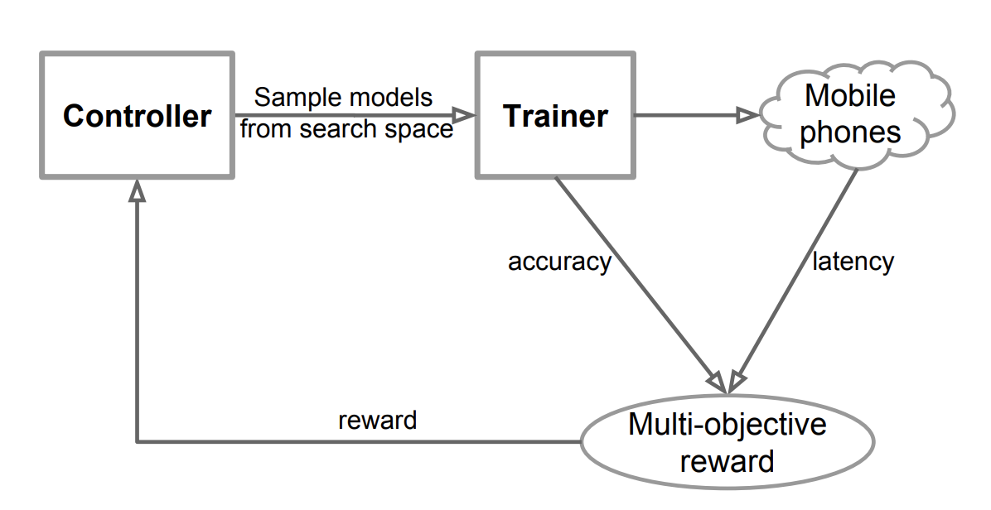
Classification: MnasNet
Idea: AutoML (Neural Architecture Search, NAS)
Paper
Code
Speed ~100ms on Mobile CPU (Pixel)

